Slide 1
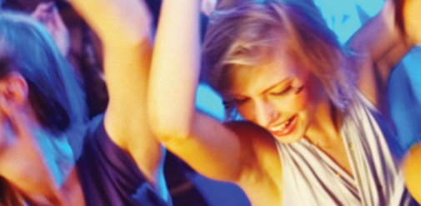
Варианты и тарифы
основной тезис ваших тарифов или вариантов (его прочтут)
Вечеринка в офисе
Вечеринка в загородном доме
Вечеринка в офисе
Описание проводимого мероприятия или ситуации или проданного товара. The universe is commonly defined as the totality of everything that exists including all physical matter and energy, the
Описание проводимого мероприятия или ситуации или проданного товара. The universe is commonly defined as the totality of everything that exists including all physical matter and energy, the
Описание проводимого мероприятия или ситуации или проданного товара. The universe is commonly defined as the totality of everything that exists including all physical matter and energy, the
• The universe
• is commonly defined
• as the totality of everything
• that exists including all
• matter and energy
• The universe
• is commonly defined
• as the totality of everything
• that exists including all
• matter and energy
• The universe
• is commonly defined
• as the totality of everything
• that exists including all
• matter and energy
Стоимость:
от 74 000 руб.
Стоимость:
от 74 000 руб.
Стоимость:
от 74 000 руб.
тел.:
e-mail:
сайт:
(495) 226-74-30
art@prcomm.ru
www.kit5.ru

